Slide 1
K-Nearest Neighbour

Slide 2
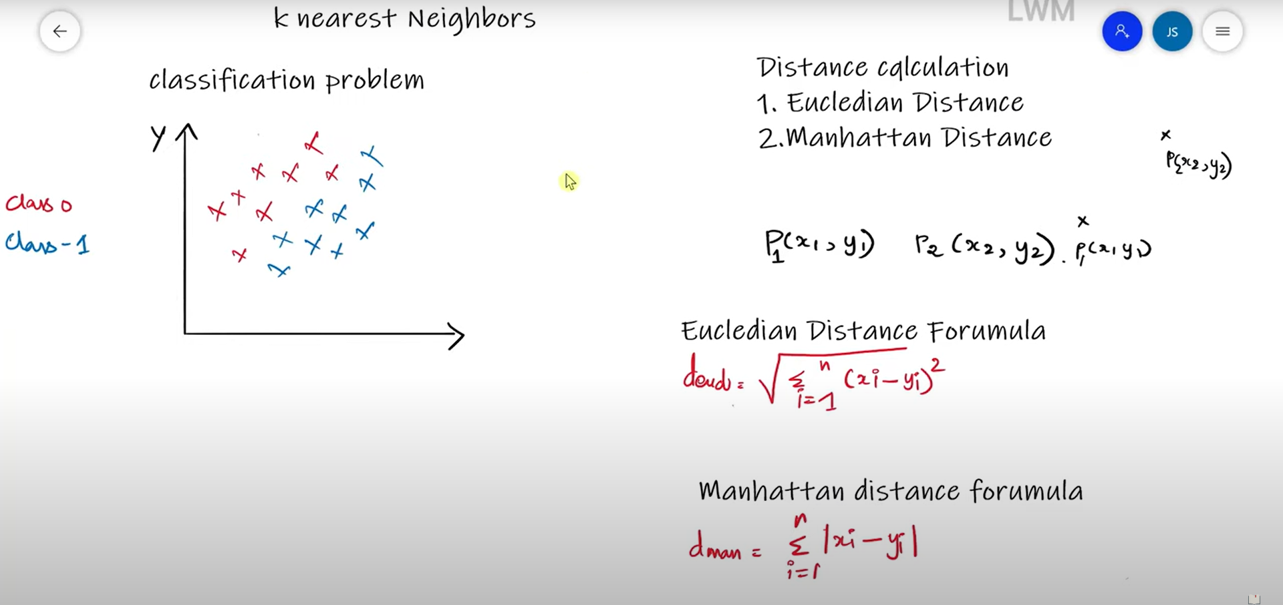

Slide 3
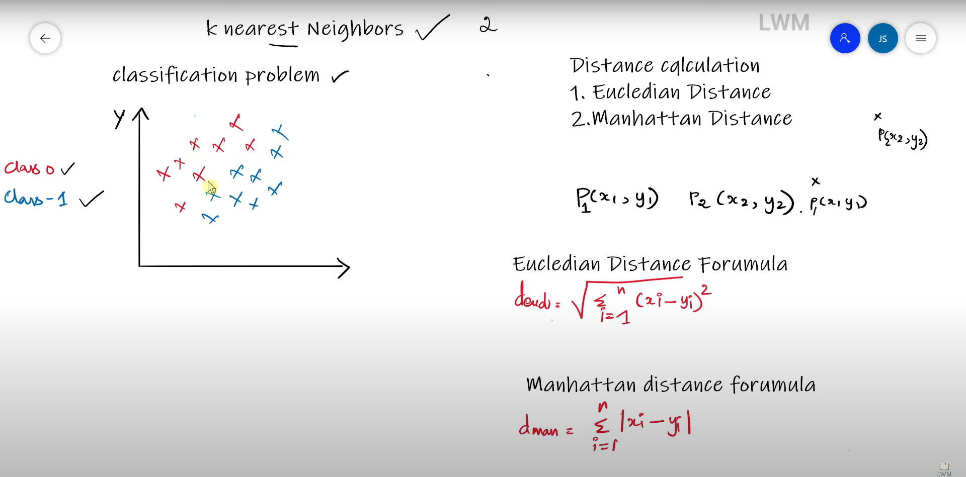

Slide 4
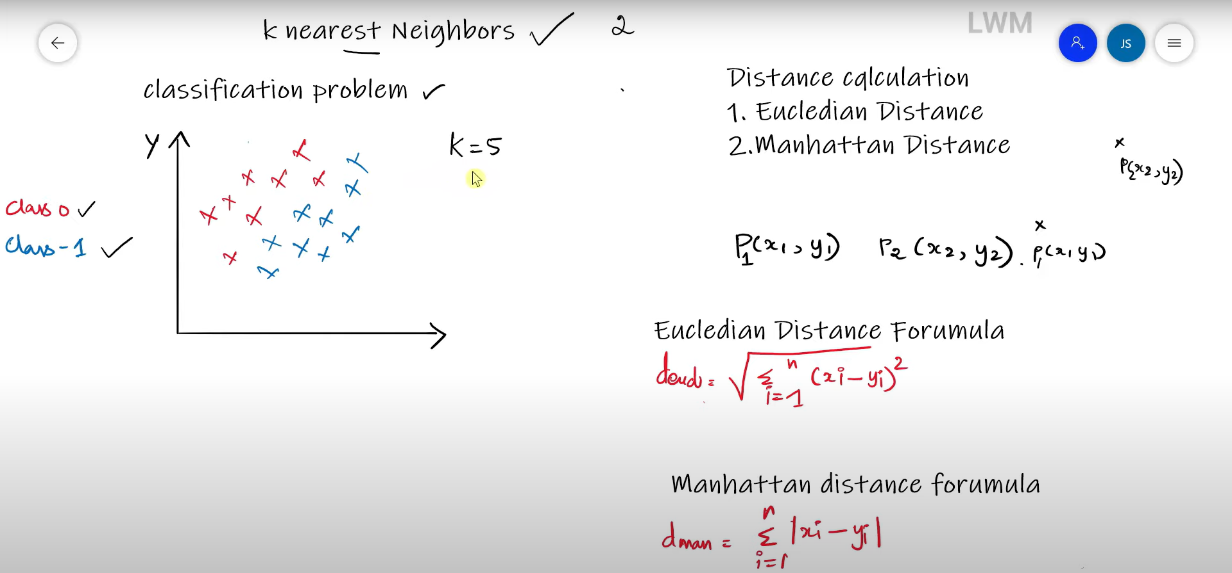

Slide 5
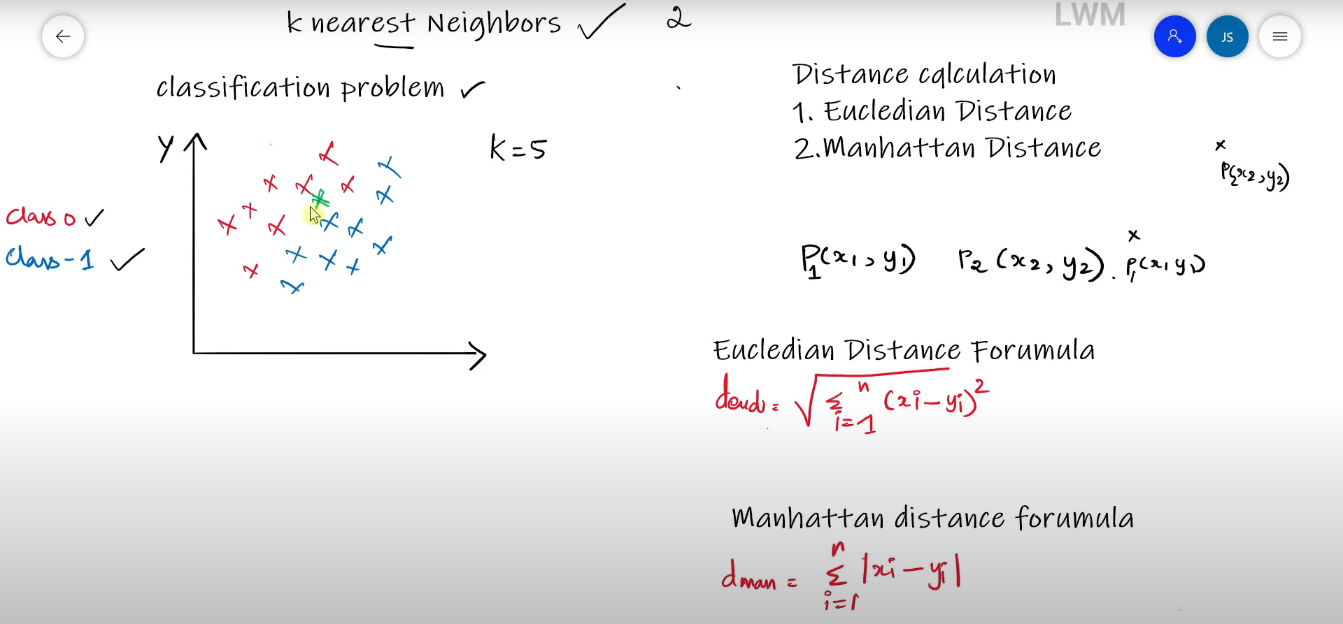

Slide 6
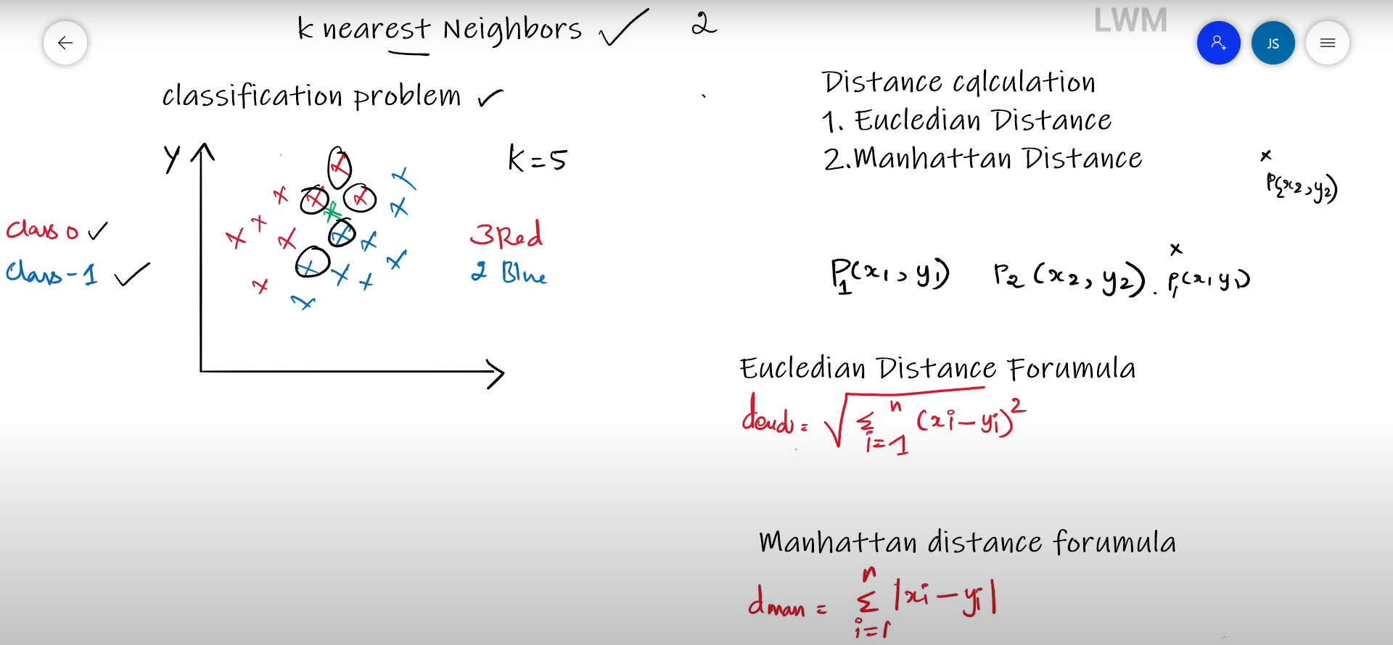

Slide 7
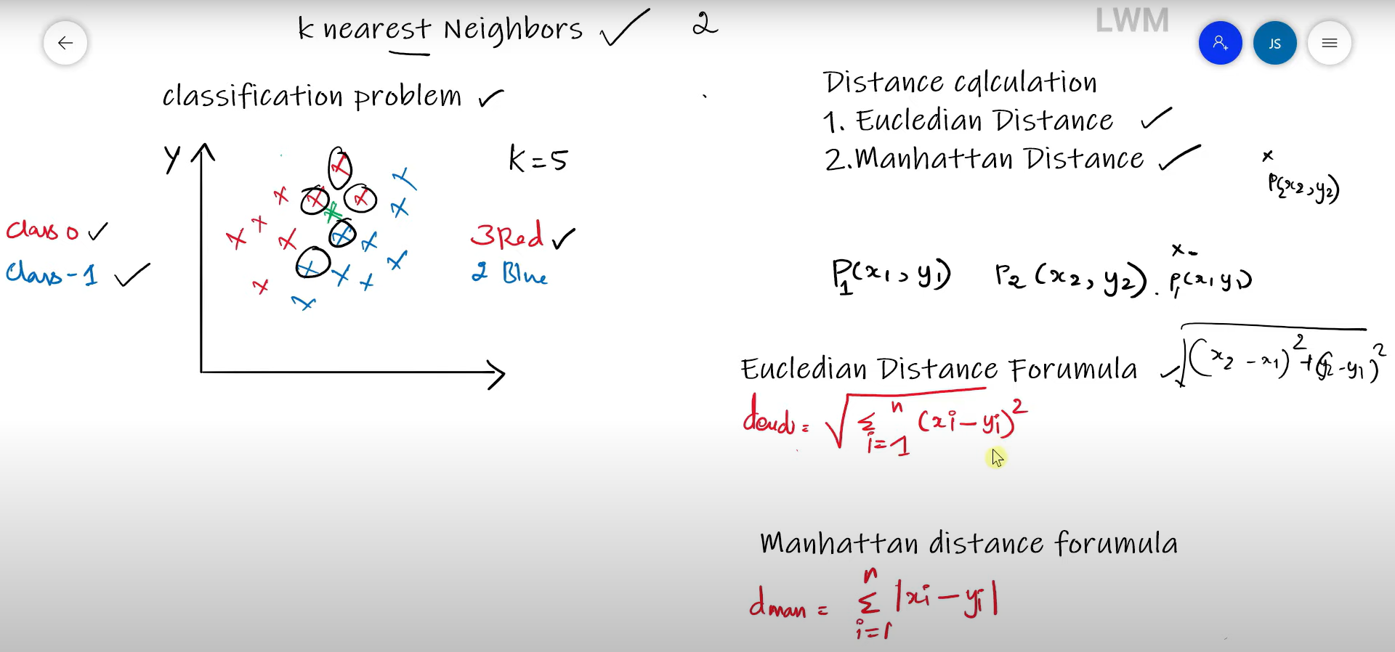

Slide 8
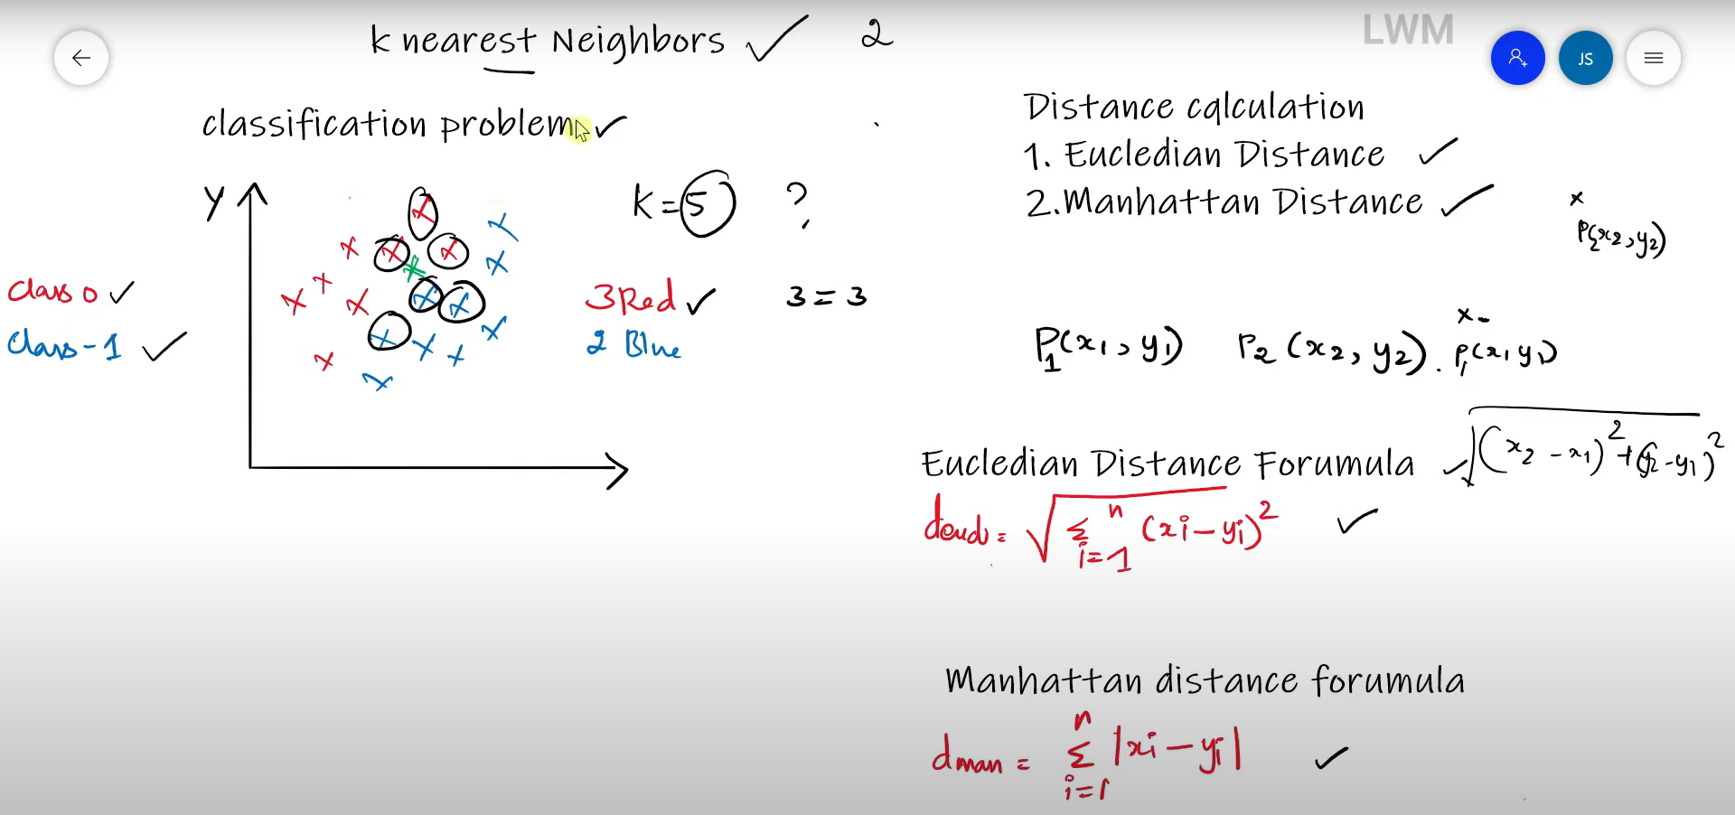

Slide 9
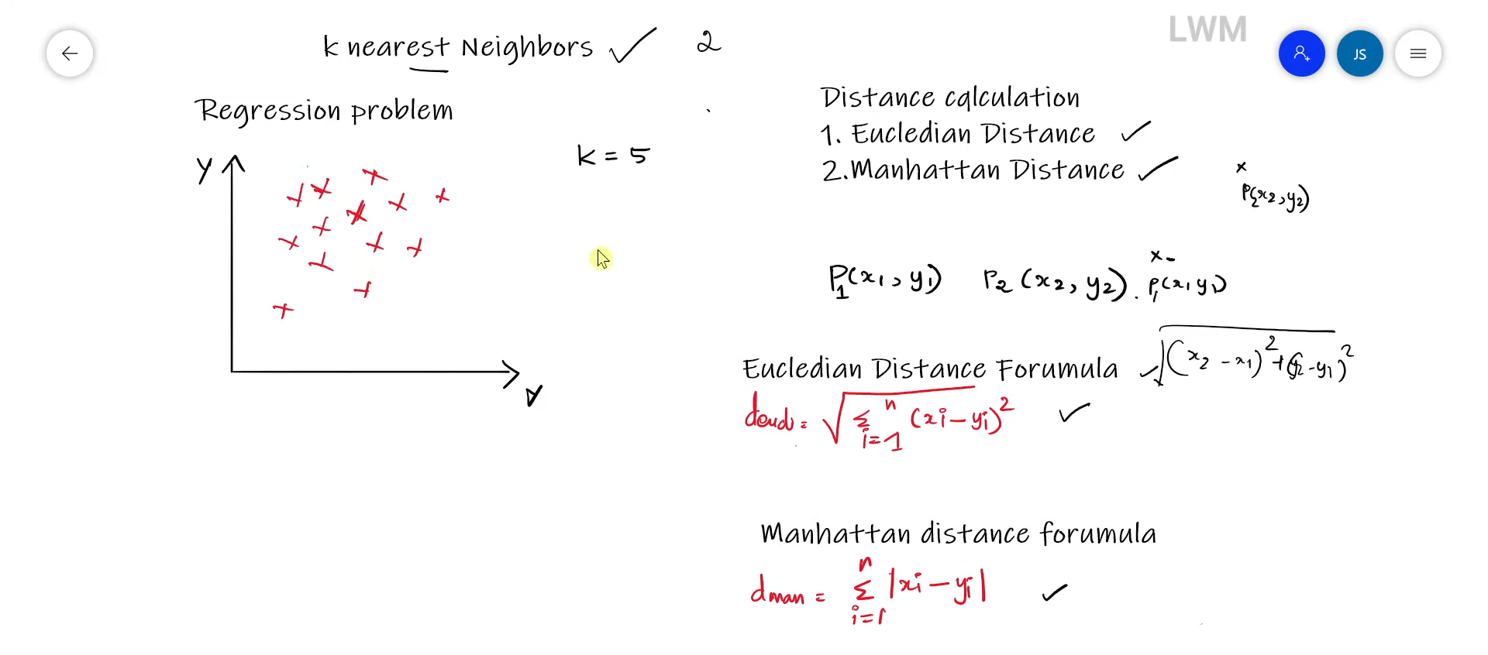

Slide 10
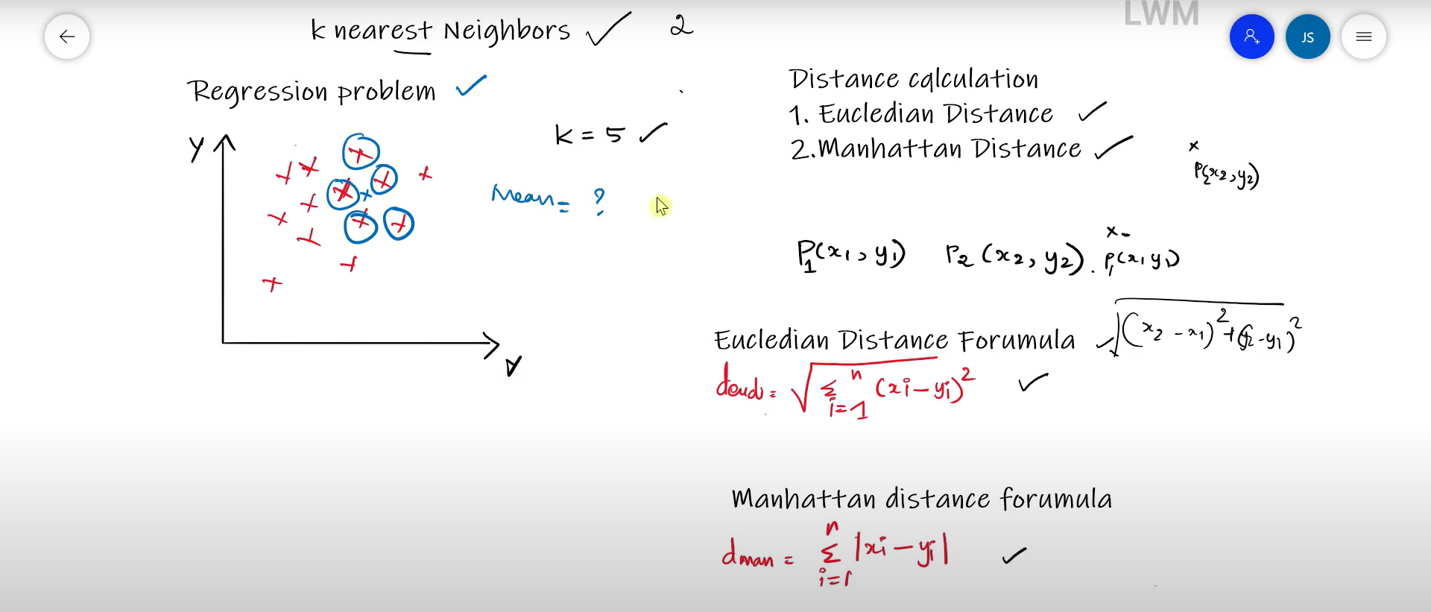

Slide 11
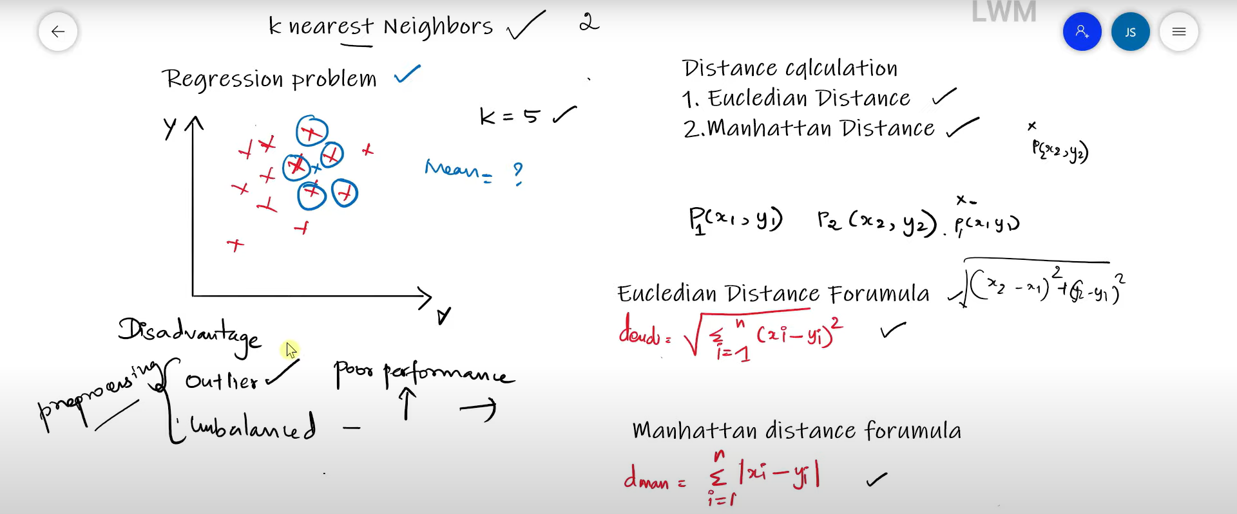
(Classification)

Slide 12
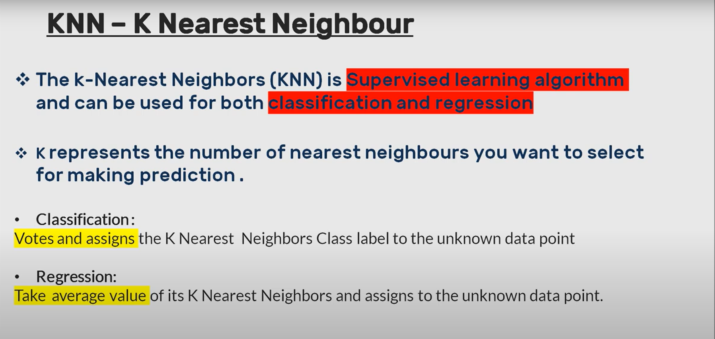
KNN-K Nearest Neighbour

Slide 13
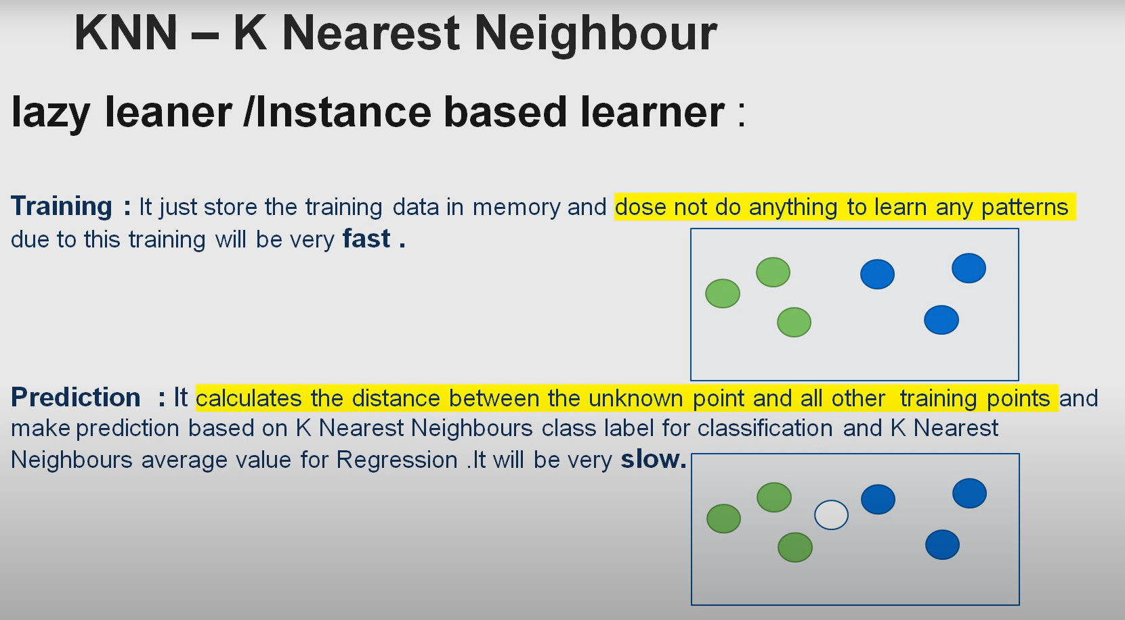

Slide 14
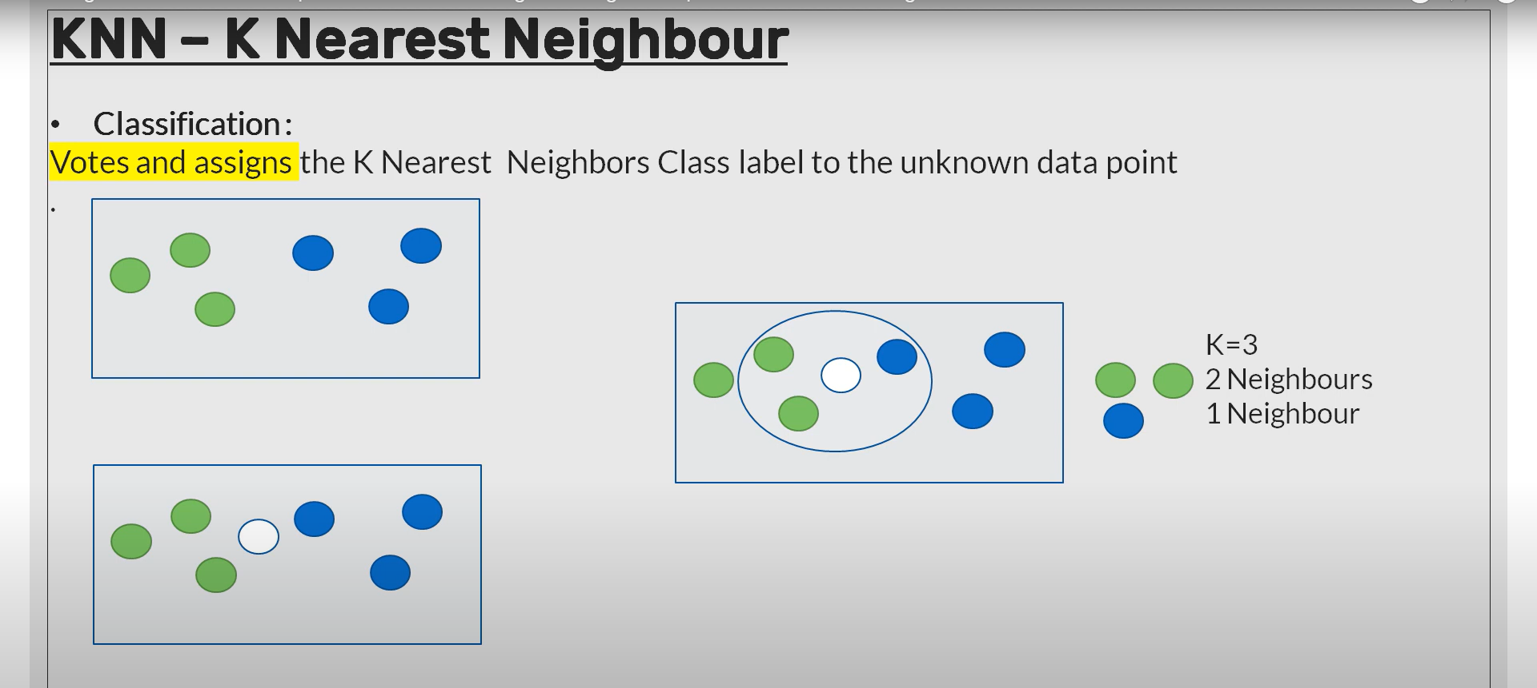

Slide 15
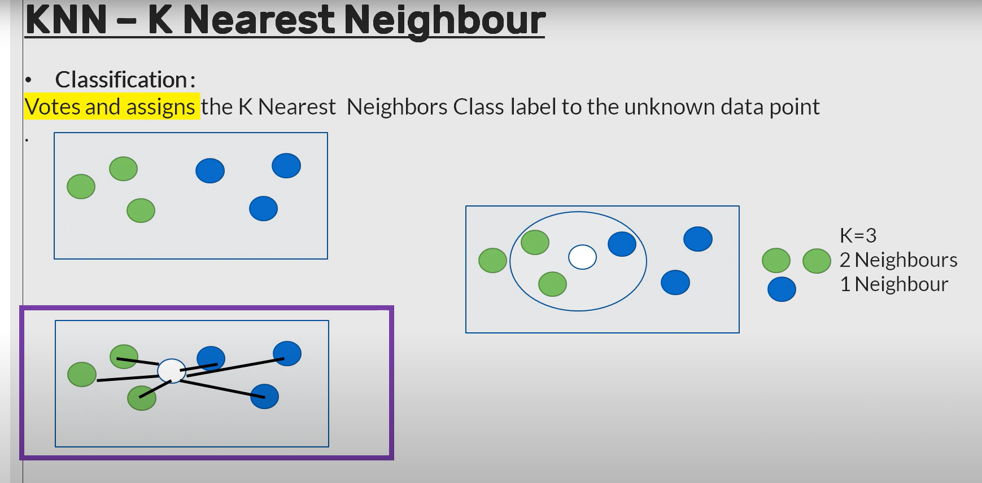

Slide 16
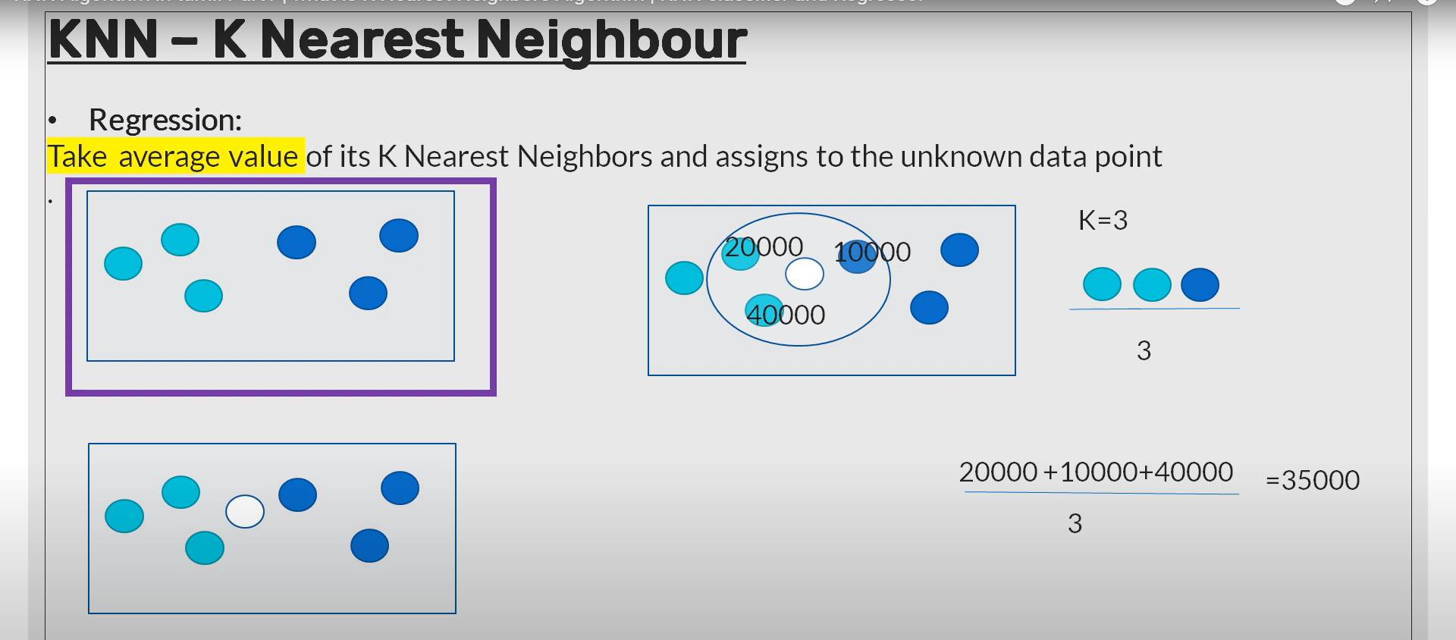

Slide 17
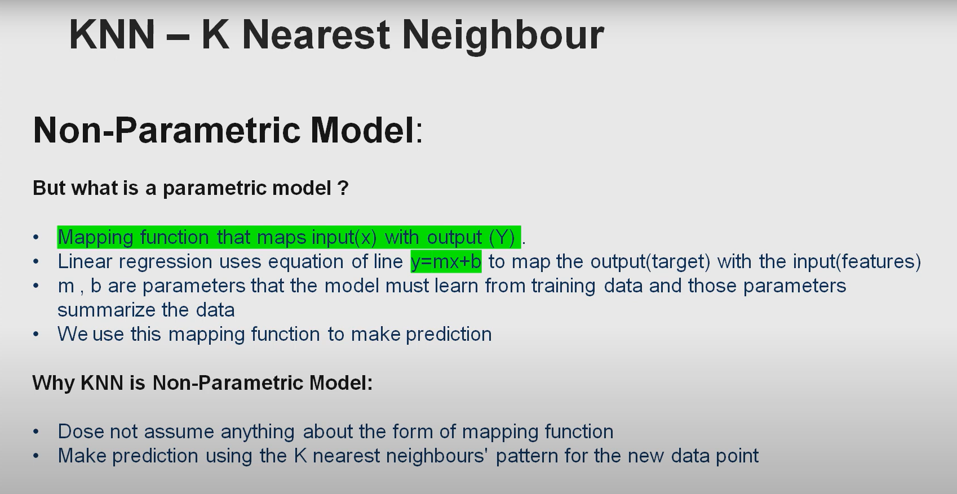

Slide 18
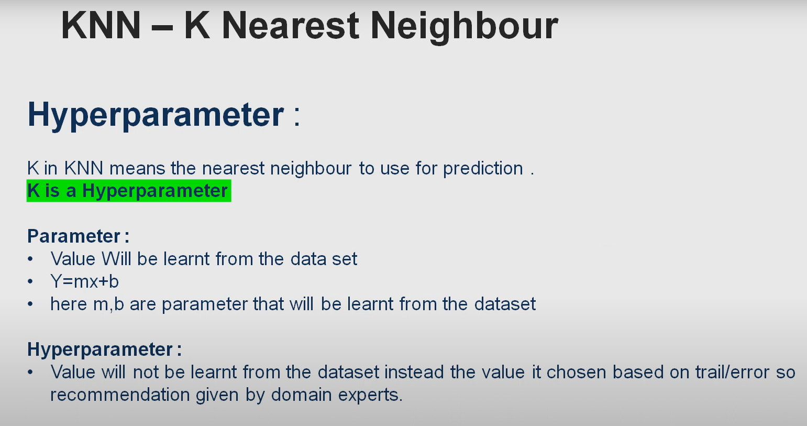

Slide 19
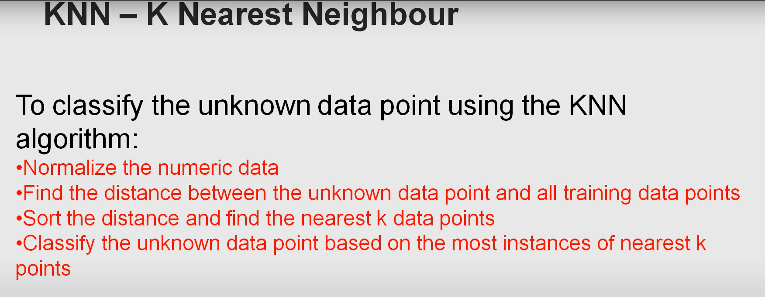

Slide 20
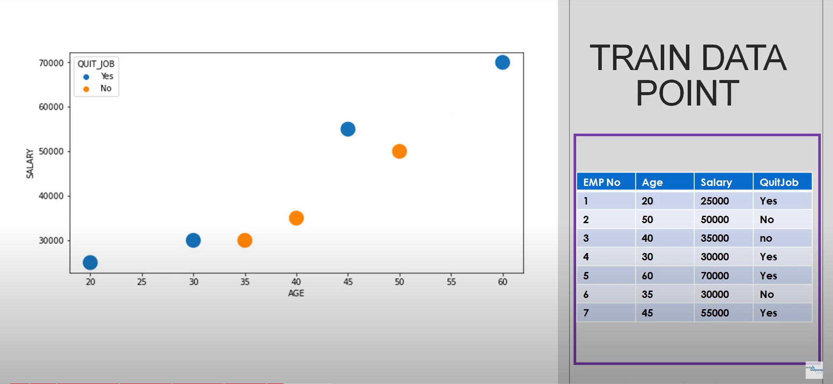

Slide 21
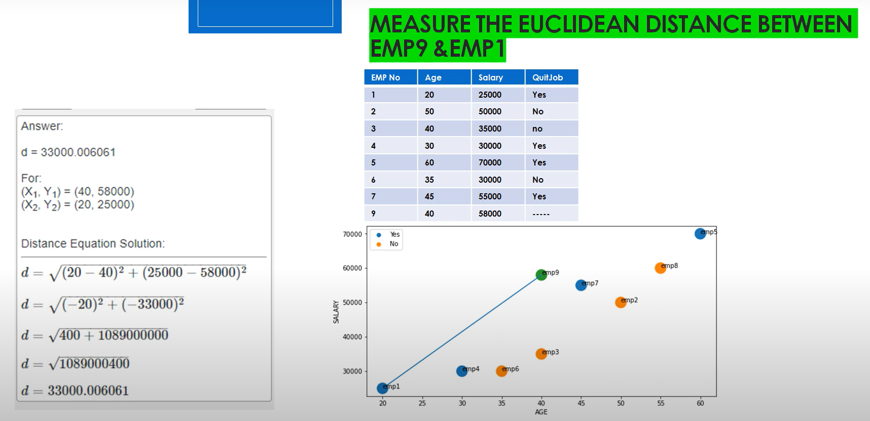

Slide 22
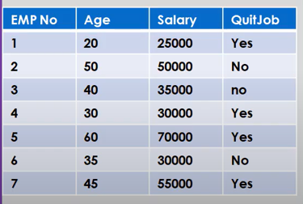
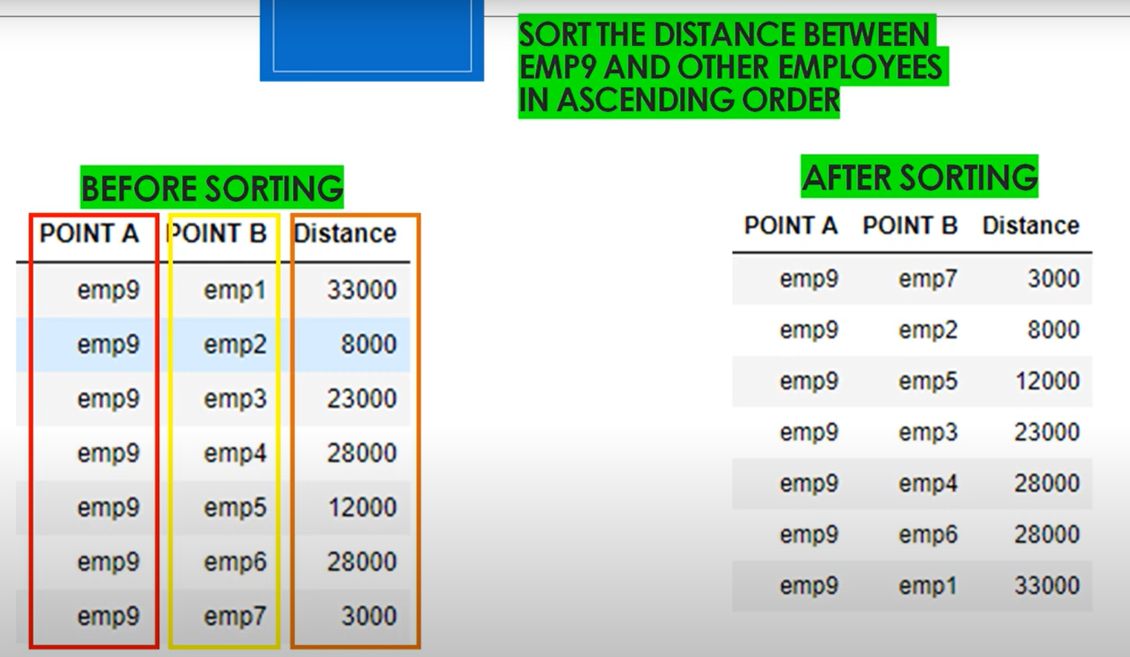
✔
✘
✔
✘
✔

Slide 23
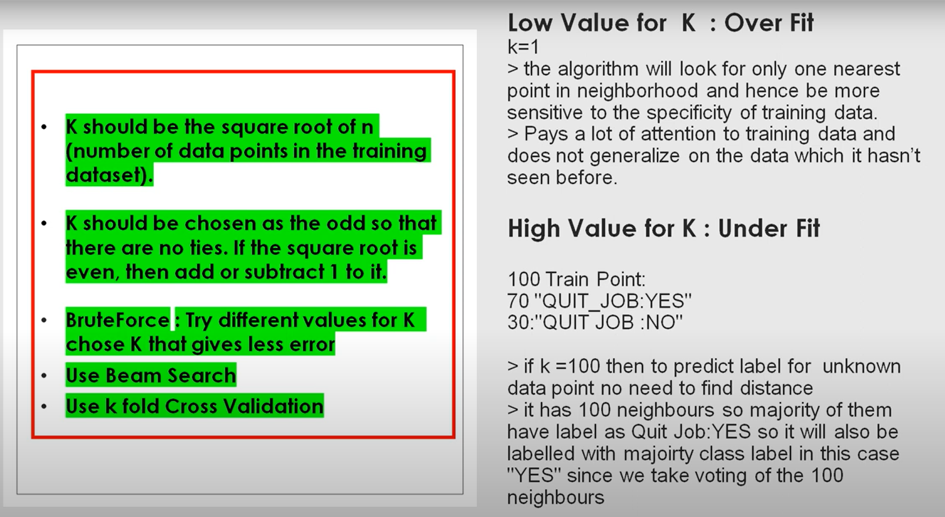

Slide 24
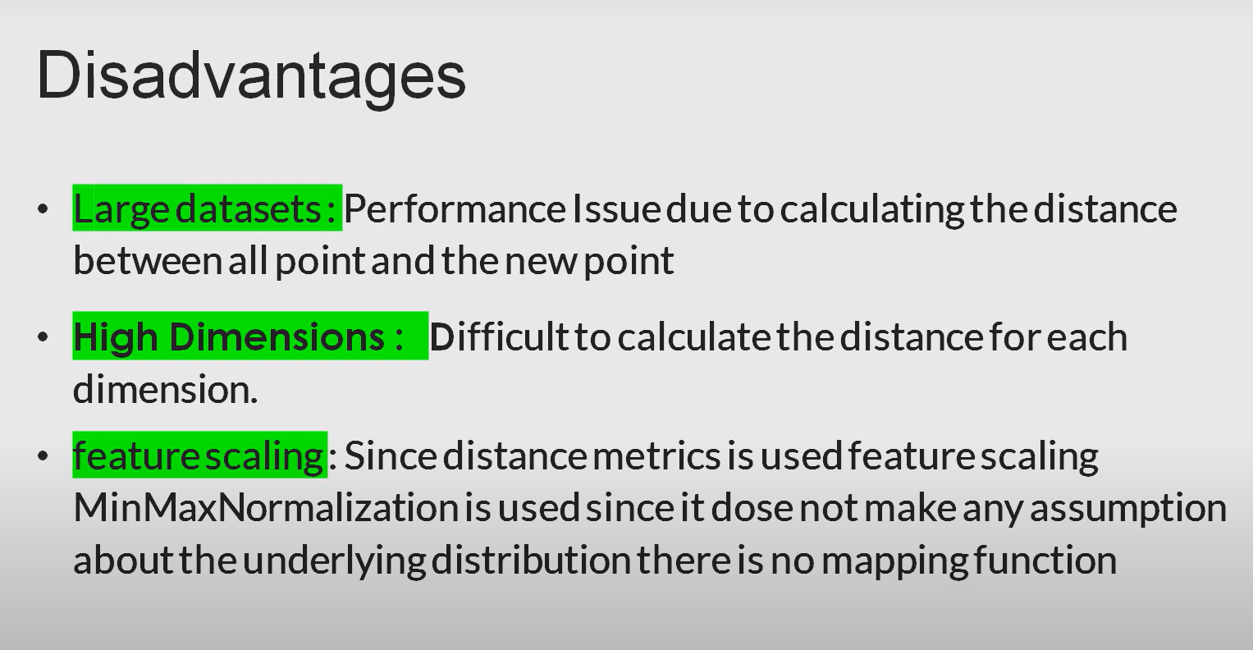

Slide 25
Feature Scaling
Feature scaling is the process of normalizing the range of features in a dataset. In the case of KNN, feature scaling can have both advantages and disadvantages.
One disadvantage of feature scaling in KNN is that it can change the distances between data points, which are used to determine the nearest neighbors. When features are scaled, their values are transformed to fit within a certain range, such as between 0 and 1. This can cause the distances between points to be distorted, which can lead to incorrect classification results.

Slide 26
Feature Scaling (cont…)
For example, consider a dataset with two features: age and income. The age values range from 20 to 80, while the income values range from 20,000 to 100,000. If these features are not scaled, the distance between two data points may be dominated by the difference in income, rather than the difference in age. However, if these features are scaled to fit within the same range, such as between 0 and 1, the distance between data points may be dominated by the difference in age, which may not be as relevant for classification.
Therefore, in some cases, feature scaling may not be appropriate for KNN, especially when the features have different units or scales, and their values are not directly comparable. In other cases, feature scaling may be beneficial for KNN, as it can improve the accuracy and speed of the algorithm by reducing the impact of features with large values.

